Slide 1
Analysis of Pseudomonas aeruginosa NADH oxidoreductase using the P. aeruginosa gene expression compendium Carson Finger (Hogan Lab)

Slide 2
PA14 gene expression compendium
The NCBI SRA database was queried for RNA samples of the organism Pseudomonas aeruginosa
Resulted in 2,867 samples (indexed by SRA “experiment” accession numbers). For these samples, each run was downloaded as a fastq file
All samples were sequenced with Illumina technologies, with read lengths ranging from 50 to 150 bp. After read mapping, read counts (NumReads) and transcripts per million (TPM)
mapped to PA14 coding DNA genome using Salmon.
RNA sequencing (RNA-seq) samples of PA01, PA14. and clinical strain samples aligned to the PA14 genome.
2,333 samples at the end
Our lab has a paper fully explaining the construction of this data set: Computationally Efficient Assembly of Pseudomonas aeruginosa Gene Expression Compendia
https://www.ncbi.nlm.nih.gov/pmc/articles/PMC9948711/

Slide 3
Gene were selected from compendia based on the list provided and analyzed to acess overall gene expression for different samples corresponding to unique experiments and environnements
Analysis of 42 genes total
1. Type II NADH:quinone Oxidoreductase (NDH-2)- ndh
2. Dihydroorotate:quinone Oxidoreductase- pyrD
3. Glycerol-3-phosphate:quinone Oxidoreductase- glpD
4. Malate:quinone Oxidoreductase- mqoa, mqob
5. ETF: quinone Oxidoreductase- etfA , etfB
6. L-proline:quinone Oxidoreductase- putA
7. D- amino acid:quinone Oxidoreductase- dadA
8. Glucose:quinone Oxidoreductase- gcd
9. Complex I- nuo nuoE , nuoH, nuoF, nuoL
10. Succinate:quinone Oxidoreductase- sdh (A-D)
11. cytochrome c oxidase- ccoN2
12. Formate dehydrogenase- fdnI , fdnG , fdnH
13. Na+-translocating NADH:quinone oxidoreductase - nqrA , nqrB, nqrC, nqrD, nqrE, nqrF
14. cytochrome bc1-cyoB
15. Cytochrome bd oxidase- cyoD
16. Nitric oxide reductases – norA, norB, norC
17. Nitrate reductase –napA, napB, napC , napD, napE, napF
18. Ion-translocating oxidoreductase-rnfB, rnfC
My housekeeping gene L-aspartate oxidase- nadB
Found differential expression profiles for:
Succinate:quinone Oxidoreductase- sdh (A-D)
Formate dehydrogenase- fdn(I,G,H)
Complex I- nuo (E,F,H,L)

Slide 4
Goals of analysis
Determine expression of NADH oxidoreductases across all samples in the compendium
Find correlations between different genes for up/down regulation
ID samples with the highest/lowest relative expression
What genes respond to environmental changes – specifically P. aeruginosa grown in sputum from people with cystic fibrosis
Lung environment adaptation

Slide 5
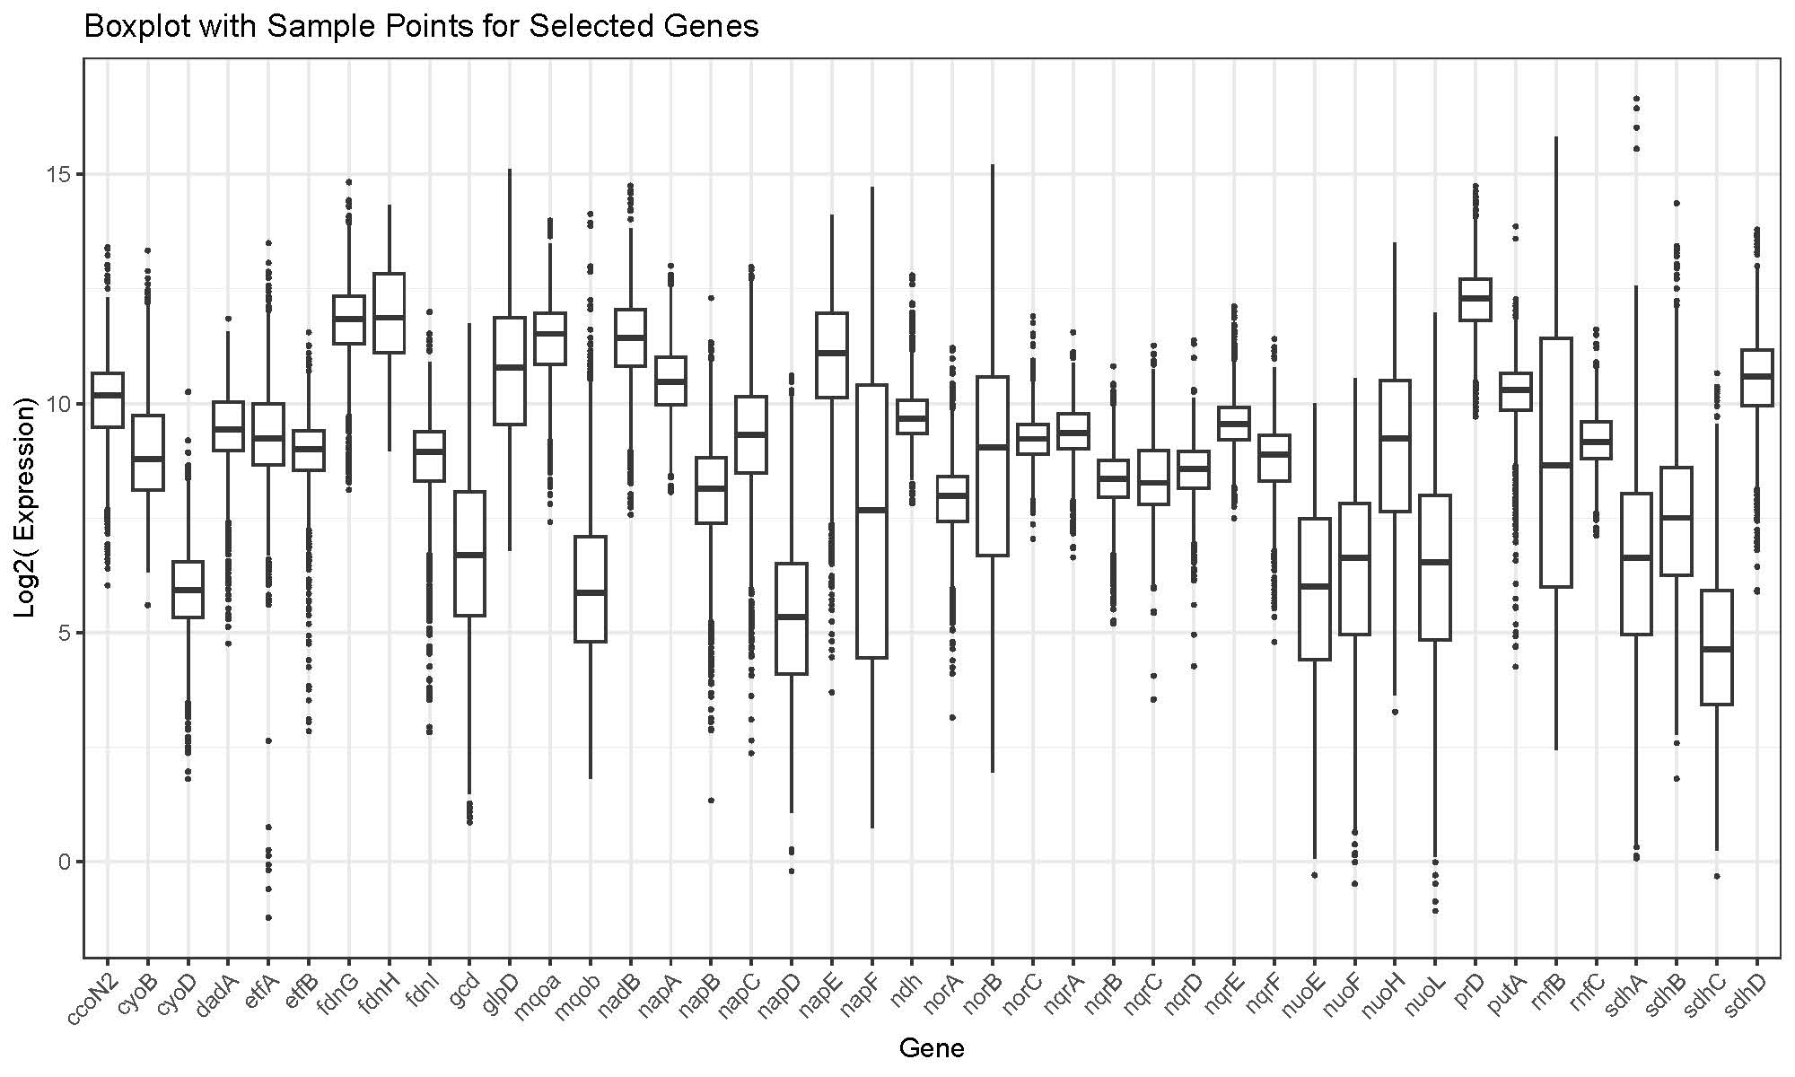
Box plot shows the relative gene expression for each sample (log scale)
Samples are represented by dots
The center line of the box represents the median and the top/bottom sides are the third/first quartiles.
first quartile is between mean and minimum
third quartile is between mean and maximum
can appreciate the spread and differences between samples

Slide 6
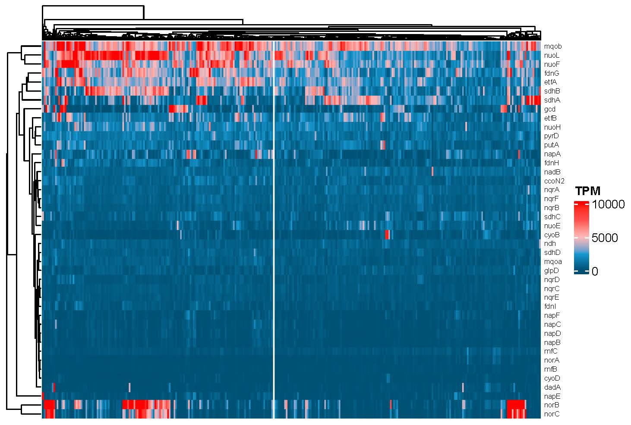
Heat maps of gene expression across all 2,333 samples shows that some genes vary more the others
Transcripts per Million (TPM) is a method for quantifying and normalizing gene expression data in RNA-seq
Genes mqoB, nuoL, nuoF, fdnG, etfA, sdhB, sdhA, norB, and norC have a larger range of gene expression over all samples (seen in yellow boxes)
Type II NADH:quinone Oxidoreductase – ndh has stable expression across samples
Samples

Slide 7
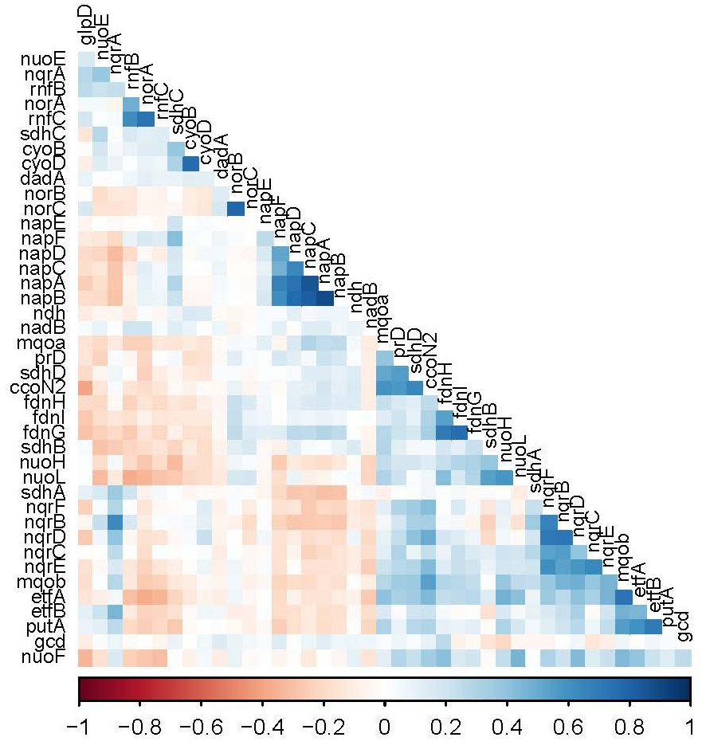
The correlation plot indicates when genes have similar or anticorrelated expression patterns
A positive coefficient of correlation indicates that genes are activated at the same time (blue)
A negative coefficient of correlation indicates an inverse relationship between genes (red)
Gene in a common operon are generally positively correlated
There could be some metabolic shifts responsible for negative correlations between genes
What upstream regulatory factors drive these shift?
Coefficient of correlation

Slide 8
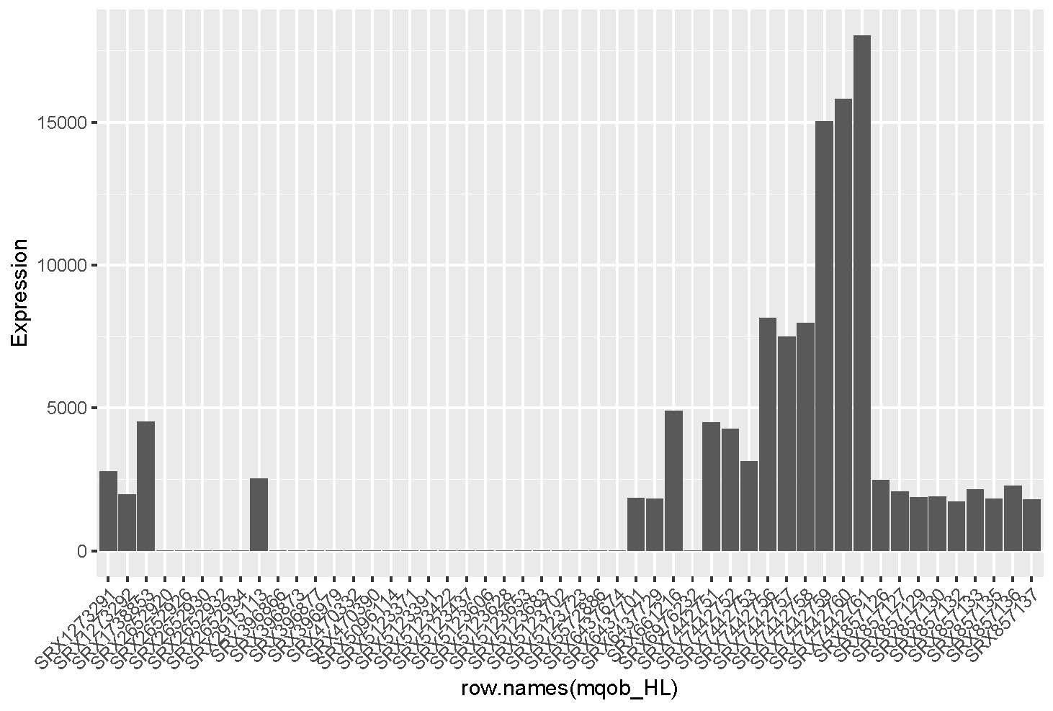
The heat map indicated that mqoB had a wide range of gene expression across different samples. The barplot displays the 25 highest and 25 lowest expression samples
-It would be interesting to find the similarities
Between high or low expression samples
Highest expressed sample: SRX7442761
Study: AB569, A Nontoxic Chemical Tandem That Kills Major Human Pathogenic Bacteria
Treatment: NaNO2.EDTA_3
Can use this website to look at any SRA ID number and find more information about the sample and the study it came from
- https://www.ncbi.nlm.nih.gov/sra/?term=SRX7442761

Slide 9
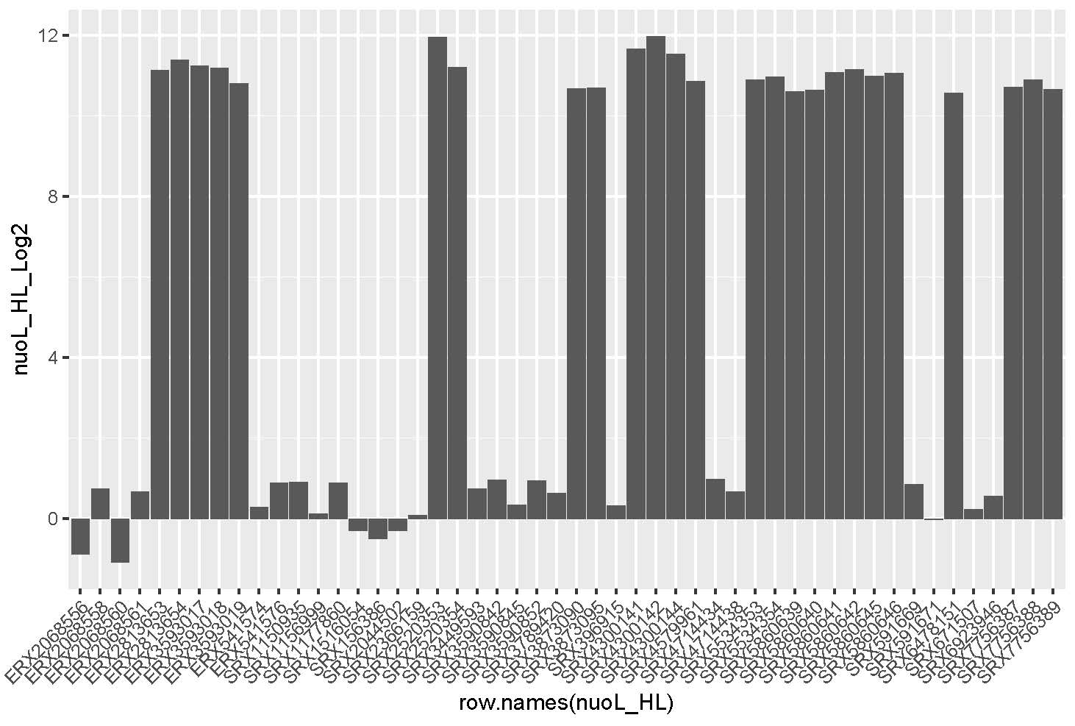
nuoL also had a wide range of gene expression across different samples. The barplot displays the 25 highest and 25 lowest expression samples (log scale)
Highly expressed samples: SRX4300142, SRX4300141, SRX4300144
Study: Broad-spectrum adaptive antibiotic resistance associated with Pseudomonas aeruginosa mucin-dependent surfing motility
Treatment: these samples were taken from the center of a colony in comparison to the edge of a colony and swimming cells
Highly expressed sample: ERX3593017
Study: Pseudmonas aeruginosa PAO1 wild-type cultured in MOPS Glycerol compared to MOPS Glycerol Hypoxia (restricted oxygen).
Treatment: Gly_Hypoxia_1

Slide 10
Several studies have analyzed P. aeruginosa gene expression in CF patient sputum
Expectorated sputum is a mixture of mucus and saliva from the patient’s lungs and airways
P. aeruginosa RNA extracted from sputum has been analyzed by RNA-seq (42 samples)

Slide 11
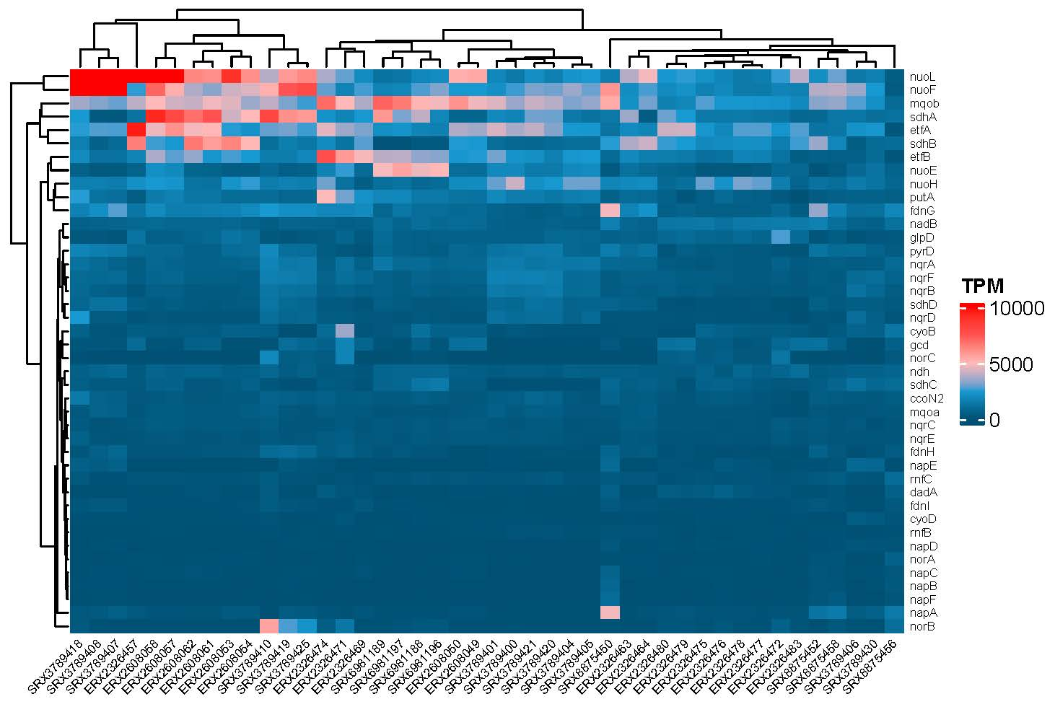
Heat map showing the relative gene expression in sputum samples (42 samples)
It is interesting that certain genes have higher levels in sputum (nuoL and nuoF)
There are no broad similarities between the sputum samples or across gene or gene families
Samples

Slide 12
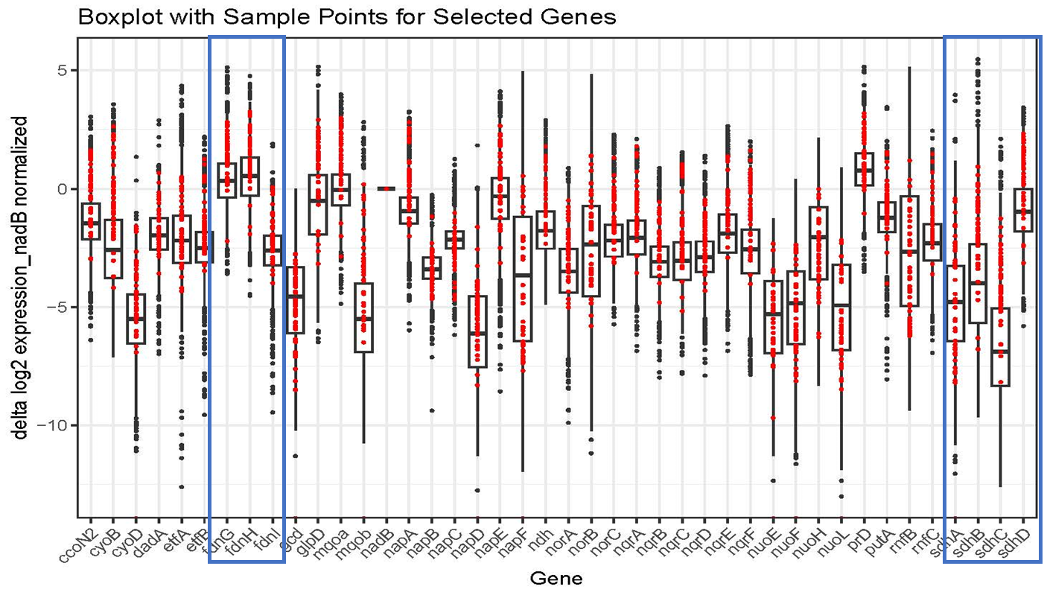
Using nadB as a housekeeping gene, samples were normalized by subtracting the expression of nadB from all other samples
The log2 of Expression values were calculated to reduce the noise of very large and small values.
Ex : log2 (100) = 6.6
Delta log2_expression: log2 expression[all other genes] - log2 expression[“nadB"]

Slide 13
Some genes are more expressed in sputum at levels higher than average expression for all samples in the compendium
The formate dehydrogenases (fdn) have two genes with similar expression and one subunit with lower expression
The succinate:quinone Oxidoreductase- sdh (A-D) also have a subunit that has a different mean expression compared to the rest of the gene family

Slide 14
For each gene the mean of all samples and mean of only sputum samples were calculated. The tables below show the difference of the means. (sputum samples - all samples )
Mean expression of Sputum is larger
Mean expression of Sputum is lower
Gene name | Mean
etfB | 3816.9
putA | 2039.7
etfA | 1947.0
sdhB | 1390.5
fdnG | 1375.6
gcd | 693.8
nuoF | 629.7
nuoE | 313.9
nqrF | 260.8
nqrE | 199.4
napA | 192.8
mqoa | 181.3
napC | 118.2
nqrD | 90.3
ccoN2 | 89.0
fdnI | 75.6
nuoL | 60.4
nqrC | 43.8
cyoB | 43.3
fdnH | 41.6
cyoD | 21.0
norC | 16.9
napD | 14.4
Gene name | Mean
napF | -1.2
napB | -2.4
napE | -5.9
norA | -22.5
norB | -27.4
glpD | -34.0
dadA | -51.4
sdhD | -57.2
nqrB | -142.9
rnfB | -148.2
rnfC | -222.6
nqrA | -317.0
ndh | -334.4
prD | -524.0
sdhC | -849.3
nuoH | -926.6
mqob | -1270.3
nadB | -1451.6
sdhA | -4296.1

